Slide 1

Variable Costing and Segment Reporting: Tools for Management
CHAPTER 6
Managerial Accounting
Seventeenth edition
As edited by prof Duquette 3-9-23

Slide 2
Learning Objective 1
Explain how variable costing differs from absorption costing and compute unit product costs under each method.

Slide 3
Four Simplifying Assumptions This way, the comparisons between VC and absorption costing van be better isolated.
This chapter uses actual costing rather than the normal costing approach that was used in the job-order costing chapters. Prof Duquette note--In other words, the overhead applied is actual overhead, not the PDOR which is a budgeted number.
This chapter always uses the actual number of units produced as the allocation base for assigning actual fixed manufacturing overhead costs to products. Prof Duquette note- vs using actual MH or DL Hrs to allocate actual costs, we use actual units produced
This chapter always assumes that the variable manufacturing costs per unit and the total fixed manufacturing overhead cost per period remain constant.
Assume no WIP at beg or ending of year, ie all units started are completed in same period, unless stated otherwise.

Slide 4
Overview of Variable and Absorption Costing
Variable Costing
Absorption Costing
Product Costs
Direct Materials
Product Costs
Direct Labor
Variable Manufacturing Overhead
Period Costs
Fixed Manufacturing Overhead
Variable Selling and Administrative Expenses
Period Costs
Fixed Selling and Administrative Expenses

Slide 5
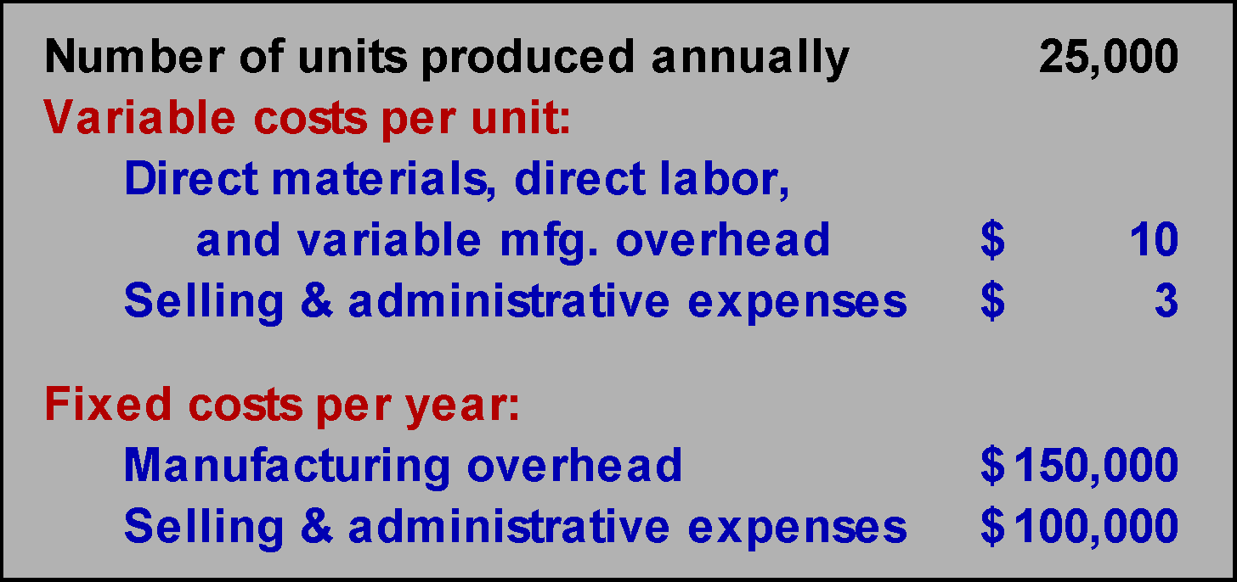
Unit Cost Computations – Part 1
Harvey Company produces a single product with the following information available:

Slide 6
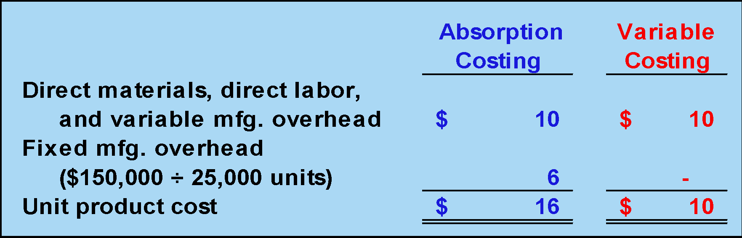
Unit Cost Computations– Part 2
Unit product cost is determined as follows:
Under absorption costing, all production costs, variable and fixed, are included when determining unit product cost. Under variable costing, only the variable production costs are included in product costs.

Slide 7
Fixed Cost Difference Between Variable versus Absorption Costing
Absorption Costing
Fixed manufacturing costs must be assigned to products , ie to inventory, to properly match revenues and costs.
Variable Costing
Fixed manufacturing costs are capacity costs and will be incurred even if nothing is produced, and therefore should be shown as period expenses.

Slide 8
Poll 1
Which method will produce the highest values for work in process and finished goods inventories?
a. Absorption costing
b. Variable costing
c. They produce the same values for these inventories
d. It depends

Slide 9
Learning Objective 2
Prepare income statements using both variable and absorption costing.

Slide 10
Variable and Absorption Costing Income Statements
Let’s assume the following additional information for Harvey Company.
20,000 units were sold during the year at a price of $30 each.
There is no beginning inventory.
Now, let’s compute net operating income using both absorption and variable costing.

Slide 11
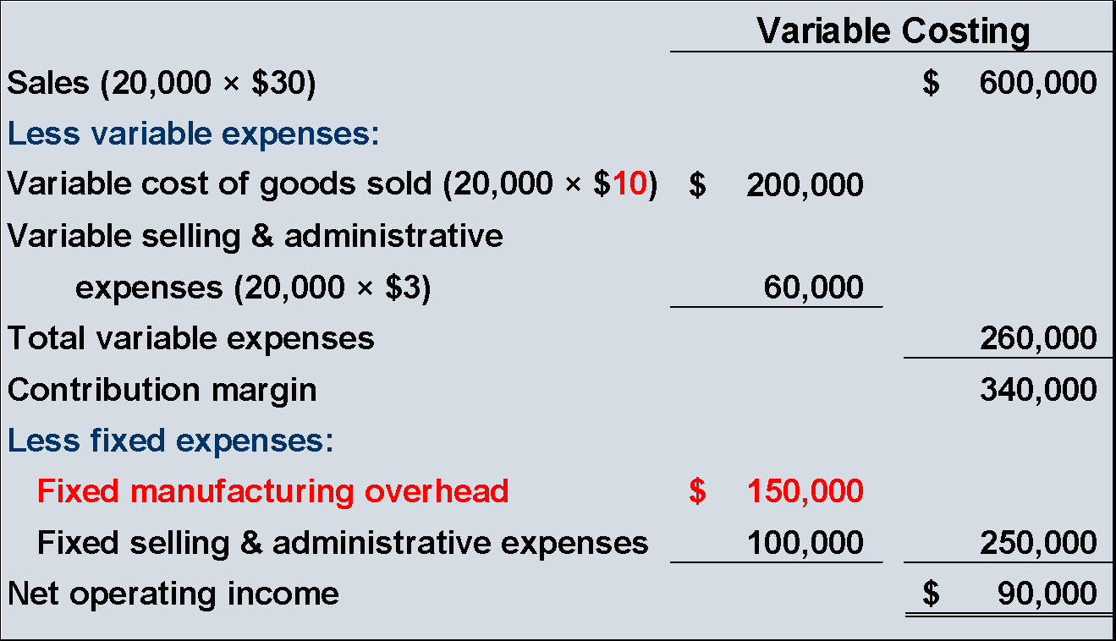
Variable Costing Contribution Format Income Statement
All fixed manufacturing overhead is expensed.
Variable manufacturing costs only.

Slide 12
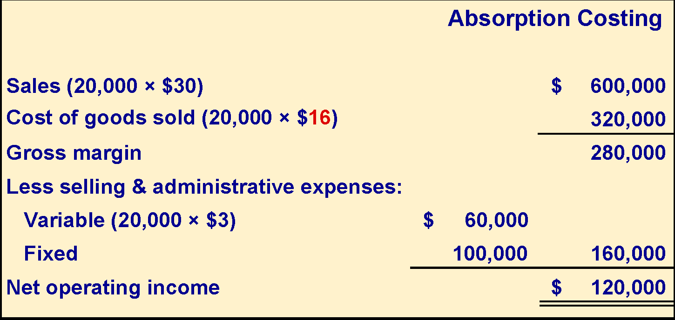
Absorption Costing Income Statement
Unit product cost.
Fixed manufacturing overhead deferred in inventory is 5,000 units × $6 = $30,000.

Slide 13
Poll 2
Which of the following is true of a company that uses absorption costing?
a. Net operating income will always be lower than shown under variable costing
b. Fixed production and fixed selling costs are considered to be product costs
c. Inventories under absorption costing include some fixed costs, but not all
d. Variable selling expenses are included in product costs

Slide 14
Learning Objective 3
Reconcile variable costing and absorption costing net operating incomes and explain why the two amounts differ.

Slide 15
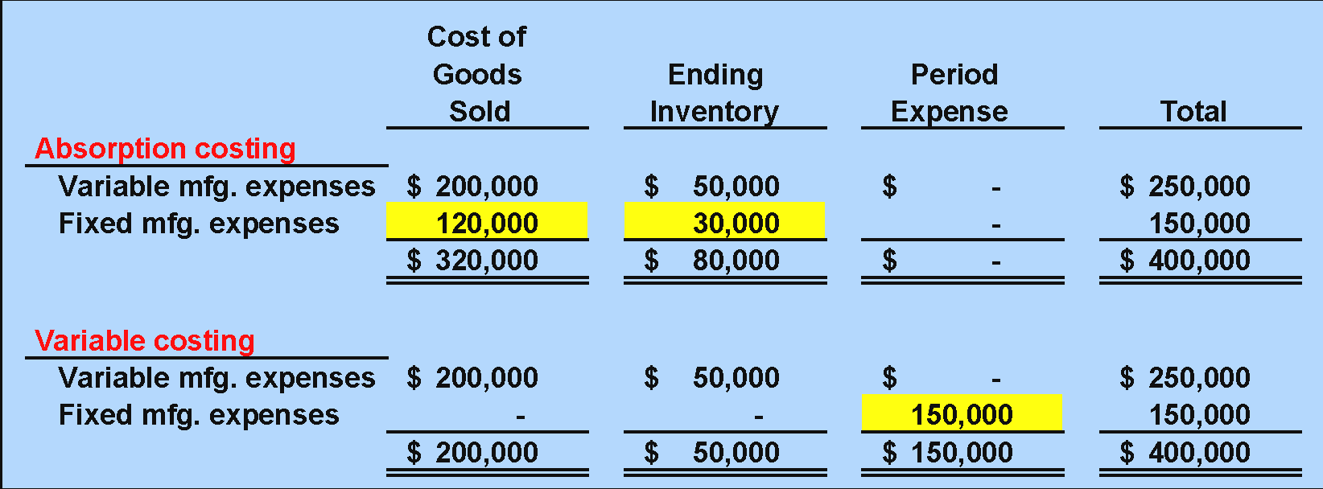
Comparing the Two Methods: Year 1

Slide 16
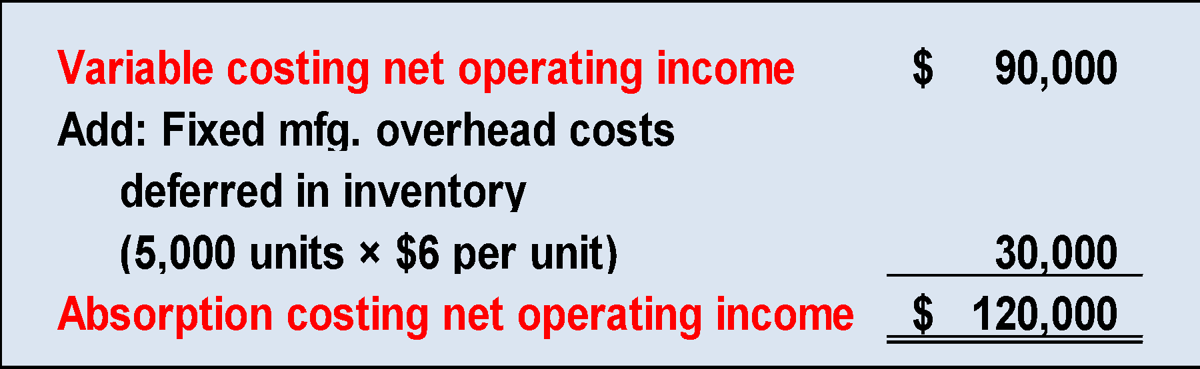
Comparing the Two Methods : Year 1
We can reconcile the difference between absorption and variable income as follows:
Fixed mfg. overhead $150,000
Units produced 25,000 units
= = $6 per unit

Slide 17
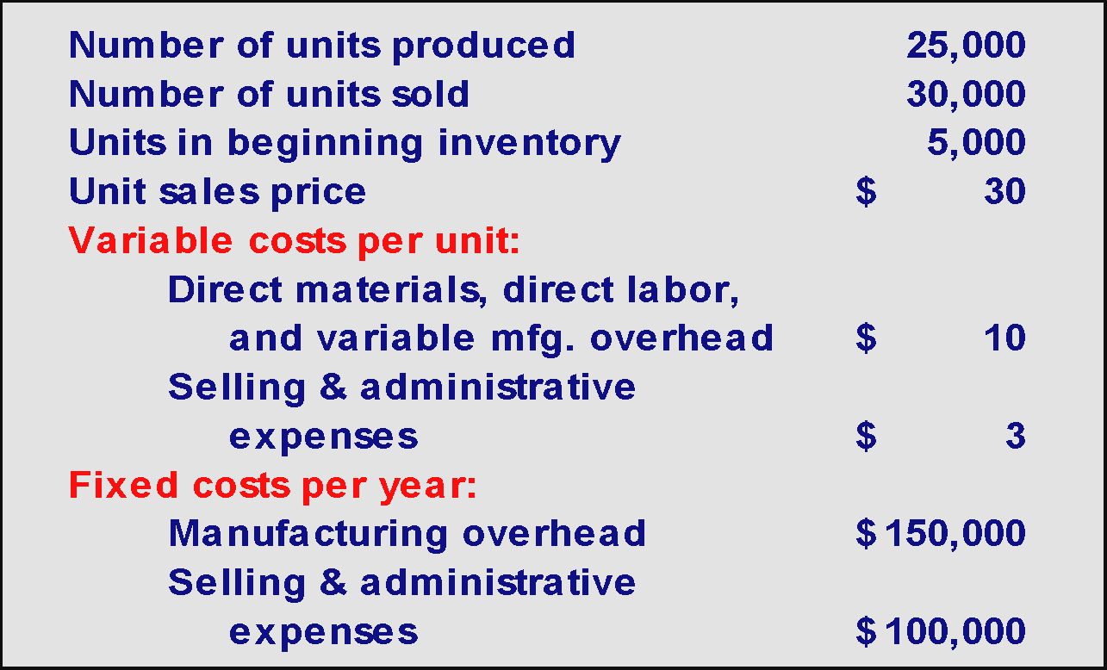
Extended Comparisons of Income Data Harvey Company – Year 2

Slide 18
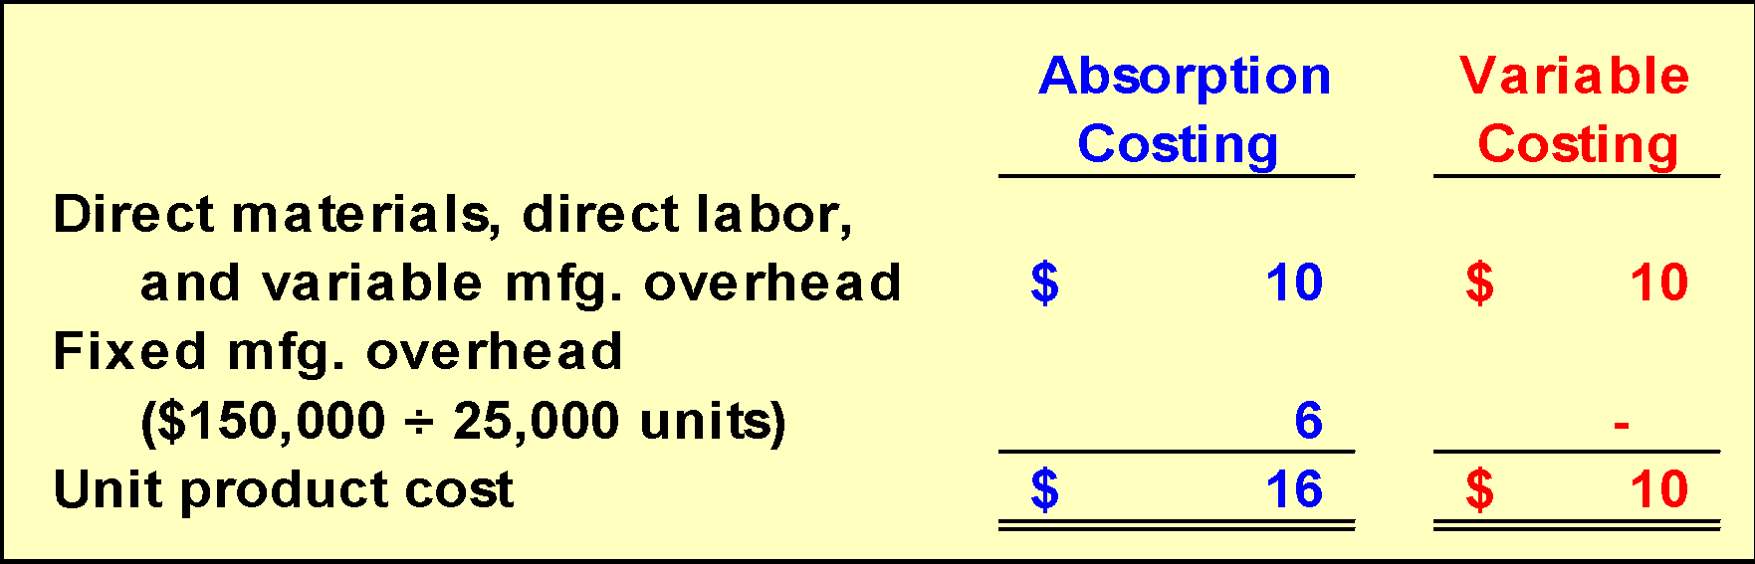
Unit Cost Computations Year 2
Since the variable costs per unit, total fixed costs, and the number of units produced remained unchanged, the unit cost computations also remain unchanged.

Slide 19
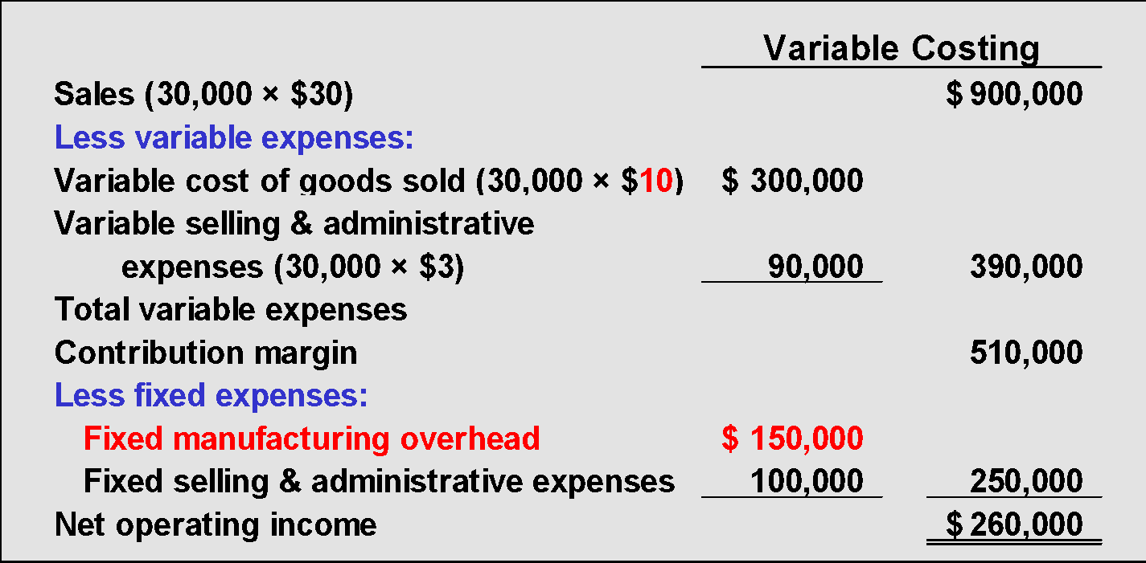
Variable Costing Contribution Format Income Statement: Year 2
All fixed manufacturing overhead is expensed.
Variable manufacturing costs only.

Slide 20
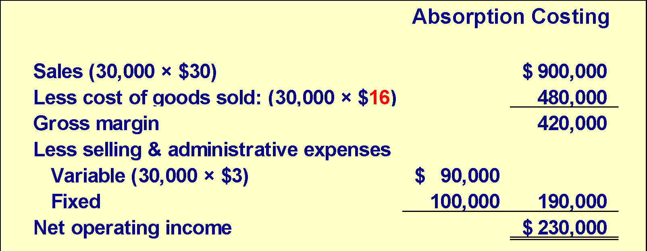
Absorption Costing Income Statement: Year 2
Unit product cost.
Fixed manufacturing overhead released from inventory is 5,000 units × $6 = $30,000.

Slide 21
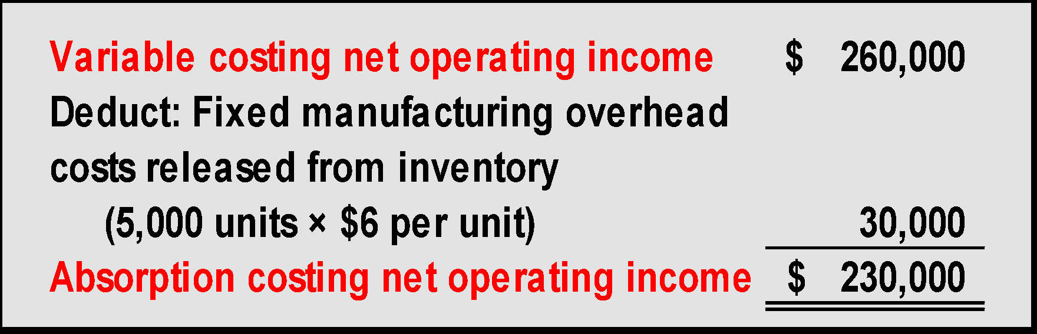
Reconciling the Difference: Year 2
We can reconcile the difference between absorption and variable income as follows:
Fixed mfg. overhead $150,000
Units produced 25,000 units
= = $6 per unit

Slide 22
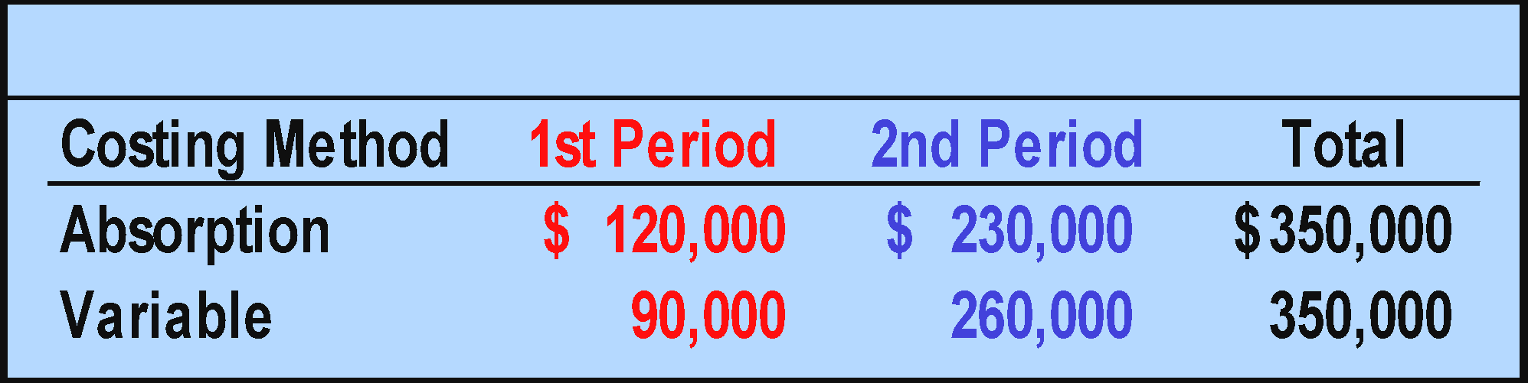
Reconciling the NOI Difference: Year 1 and 2

Slide 23
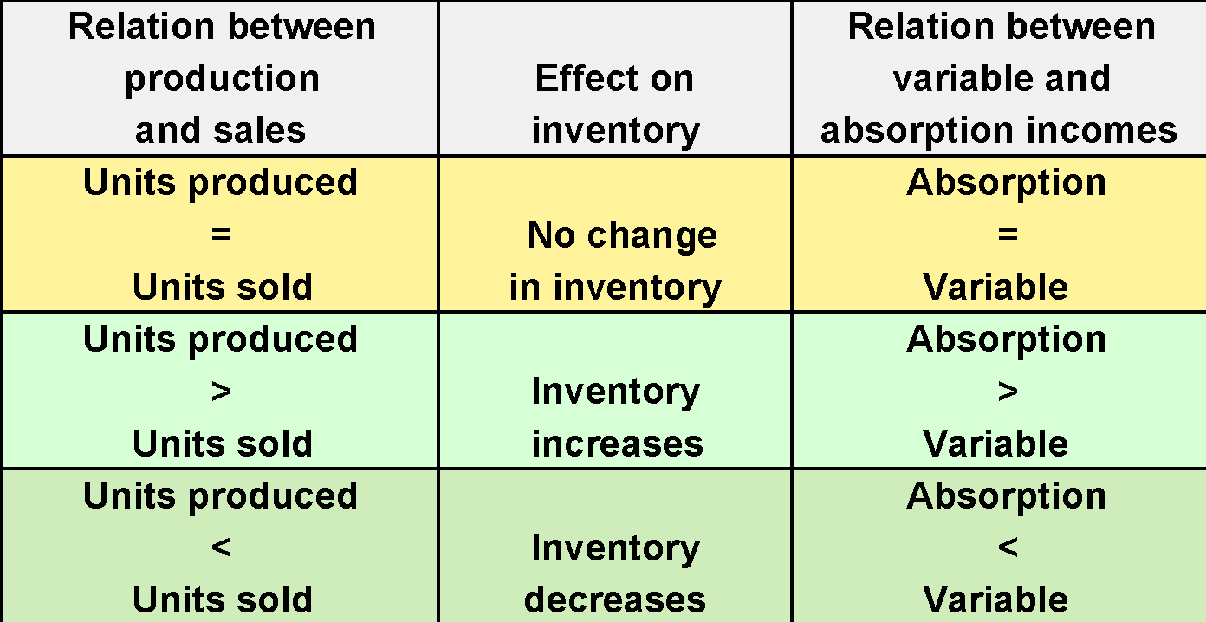
Summary of Key Insights

Slide 24
In Summary: VC Enables More Accurate CVP & BE Analysis
Absorption costing net income:
Assigns fixed manufacturing overhead costs to units produced ($6 per unit for Harvey Company).
Therefore, a portion of each month’s fixed manufacturing overhead resides in inventory when units remain unsold.
The potential result is more operating income even when the number of units sold is less than the true breakeven point.
That is because the BE point under GAAP is much lower if some fixed expenses are not expensed but rather are sitting in inventory.
Variable costing net income :
Categorizes costs as variable and fixed so it is much easier and more accurate to use this income statement format for CVP analysis.

Slide 25
In Summary: Variable costing allows easier understanding of Changes in Net Operating Income
Absorption costing net income :
Is influenced by changes in unit sales and units of production.
Under absorption costing, net income can be increased simply by producing more units even if those units are not sold.
This confuses what is really happening to affect net income. Managers may wonder why NI went up: was it because of variable costs down, fixed costs down, sales units up, sales price up, lower selling costs, more efficient production?
Variable costing net income:
Is only affected by changes in units sold. It is not affected by the number of units produced.
As a general rule, under variable costing, when sales go up, net operating income goes up, as long as the selling price exceeds VC per unit.

Slide 26
In Summary: Variable Costing Supports Decision Making Better
Absorption costing Net Income:
Assigns fixed manufacturing overhead costs to units produced ($6 per unit for Harvey Company), giving the impression that fixed manufacturing overhead is variable with respect to the number of units produced, but it is not.
The result can be inappropriate pricing decisions and product discontinuation decisions.
Variable costing Net Income:
Correctly identifies the additional variable costs incurred to make one more unit ($10 per unit for Harvey Company).
It also emphasizes the impact of total actual fixed costs on profits.

Slide 27
Poll 3
Generally speaking, net operating income under variable and absorption costing will:
a. always be equal
b. never be equal
c. be equal only when production and sales are equal
d. be equal only when production exceeds sales

Slide 28
Poll LO 4
Net operating income computed under variable costing would exceed net operating income computed using absorption costing if:
units sold exceed units produced
units sold are less than units produced
units sold equal units produced
the average fixed cost per unit is zero

Slide 29
Learning Objective 4
Prepare a segmented income statement that differentiates traceable fixed costs from common fixed costs and use it to make decisions.

Slide 30
Decentralization and Segment Reporting
A segment is any part or activity of an organization about which a manager seeks cost, revenue, or profit data.
An Individual Store
A Service Center
A Sales Territory

Slide 31
Keys to Segmented Income Statements
There are two keys to building segmented income statements:
A contribution format should be used because it separates fixed from variable costs and it enables the calculation of a contribution margin.
Traceable fixed costs should be separated from common fixed costs to enable the calculation of a segment margin.

Slide 32
Identifying Traceable Fixed Costs
Traceable fixed costs arise because of the existence of a particular segment and would disappear over time if the segment itself disappeared.
Examples of traceable fixed costs include:
The salary of the Fritos product manager at PepsiCo is a traceable fixed cost of the Fritos business segment of PepsiCo.
The maintenance cost for the building in which Boeing 747s are assembled is a traceable fixed cost of the 747 business segment of Boeing.

Slide 33
Identifying Common Fixed Costs
Common fixed costs arise because of the overall operation of the company and would not disappear if any particular segment were eliminated.
Examples of common fixed costs include:
The salary of the CEO of General Motors is a common fixed cost of the various divisions of General Motors.
The cost of heating a Safeway or Kroger grocery store is a common fixed cost of the various departments.

Slide 34
Traceable Fixed Costs
It is important to realize that the traceable fixed costs of one segment may be a common fixed cost of another segment.

Slide 35
Segment Margin
The segment margin, which is computed by subtracting the traceable fixed costs of a segment from its contribution margin, is the best gauge of the long-run profitability of a segment.

Slide 36
Traceable and Common Costs
Fixed
Costs
Don’t allocate
common costs to segments.
Traceable
Common

Slide 37
Levels of Segmented Statements – Part 1
Webber, Inc. has two divisions.
Computer Division
Television Division
Let’s look more closely at the Television Division’s income statement.

Slide 38
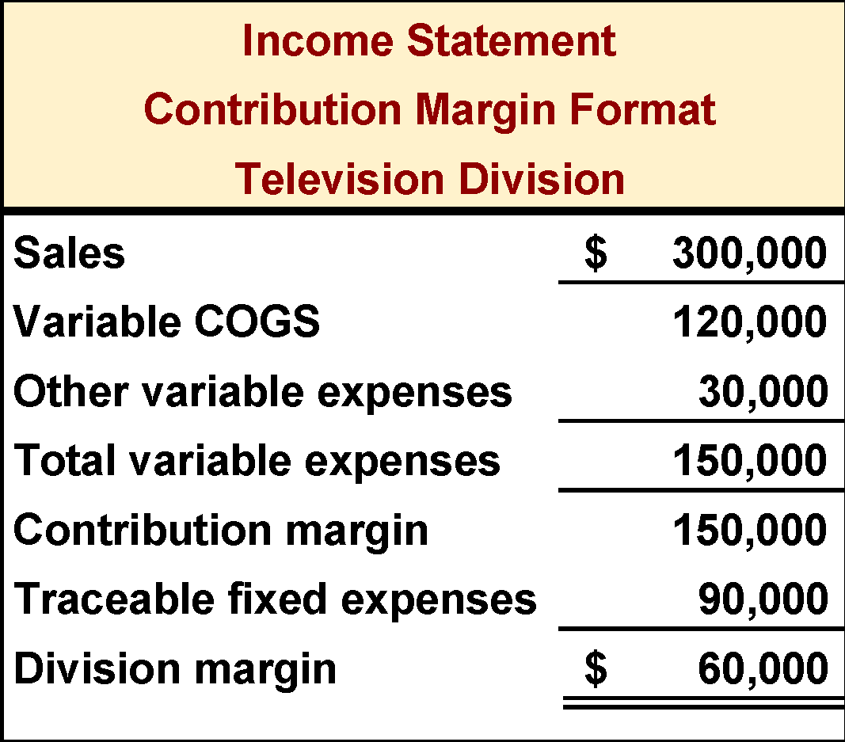
Levels of Segmented Statements – Part 2
Our approach to segment reporting uses the contribution format.
Cost of goods
sold consists of
variable manufacturing
costs.
Fixed and
variable costs
are listed in
separate
sections.

Slide 39
Levels of Segmented Statements – Part 3
Our approach to segment reporting uses the contribution format.
Contribution margin
is computed by taking sales minus variable costs.
Segment margin
is Television’s
contribution
to profits.

Slide 40
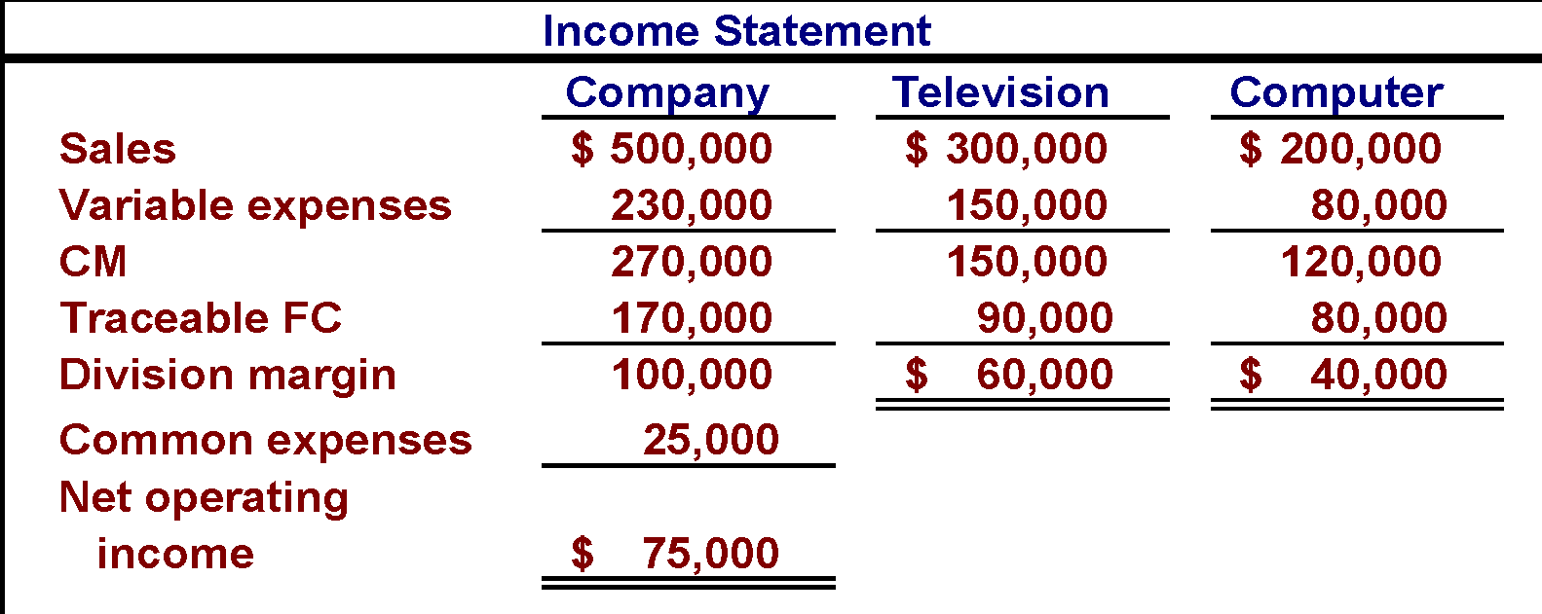
Levels of Segmented Statements – Part 4
Common fixed expenses should not be allocated to the divisions. These expenses would remain even if one of the divisions were eliminated.

Slide 41
Traceable Fixed Costs Can Become Common Fixed Costs – Part 1
As previously mentioned, fixed expenses that are traceable to one segment can become common fixed expenses if the company is divided into smaller segments.
Let’s see how this works using the Webber, Inc. example.

Slide 42
Traceable Fixed Costs Can Become Common Fixed Costs – Part 2
Webber’s Television Division has two product lines:
Regular
Big Screen

Slide 43
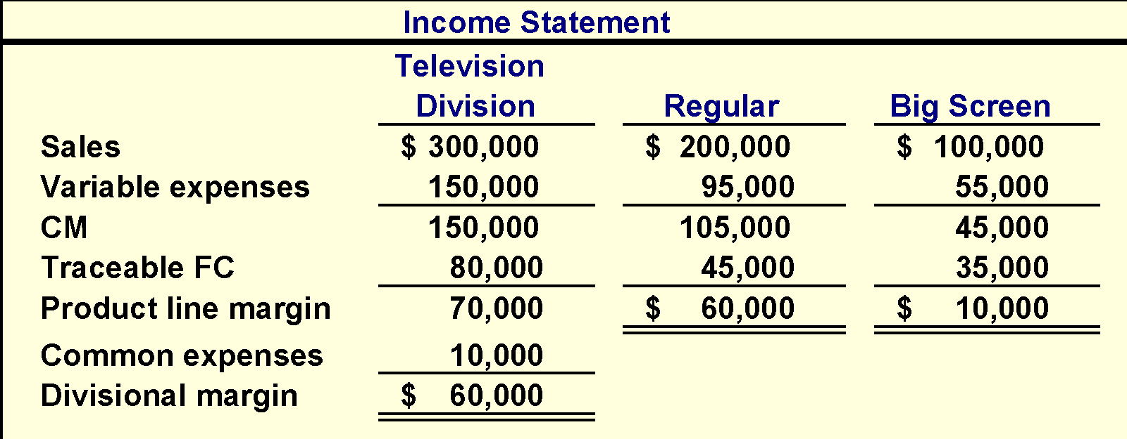
Traceable Fixed Costs Can Become Common Fixed Costs – Part 3
Fixed costs directly traced
to the Television Division
$80,000 + $10,000 = $90,000

Slide 44
Segmented Income Statements— Decision Making and Break-even Analysis
Once a company prepares a contribution format segmented income statement, it can use
the statement to make decisions and perform break-even analysis.

Slide 45
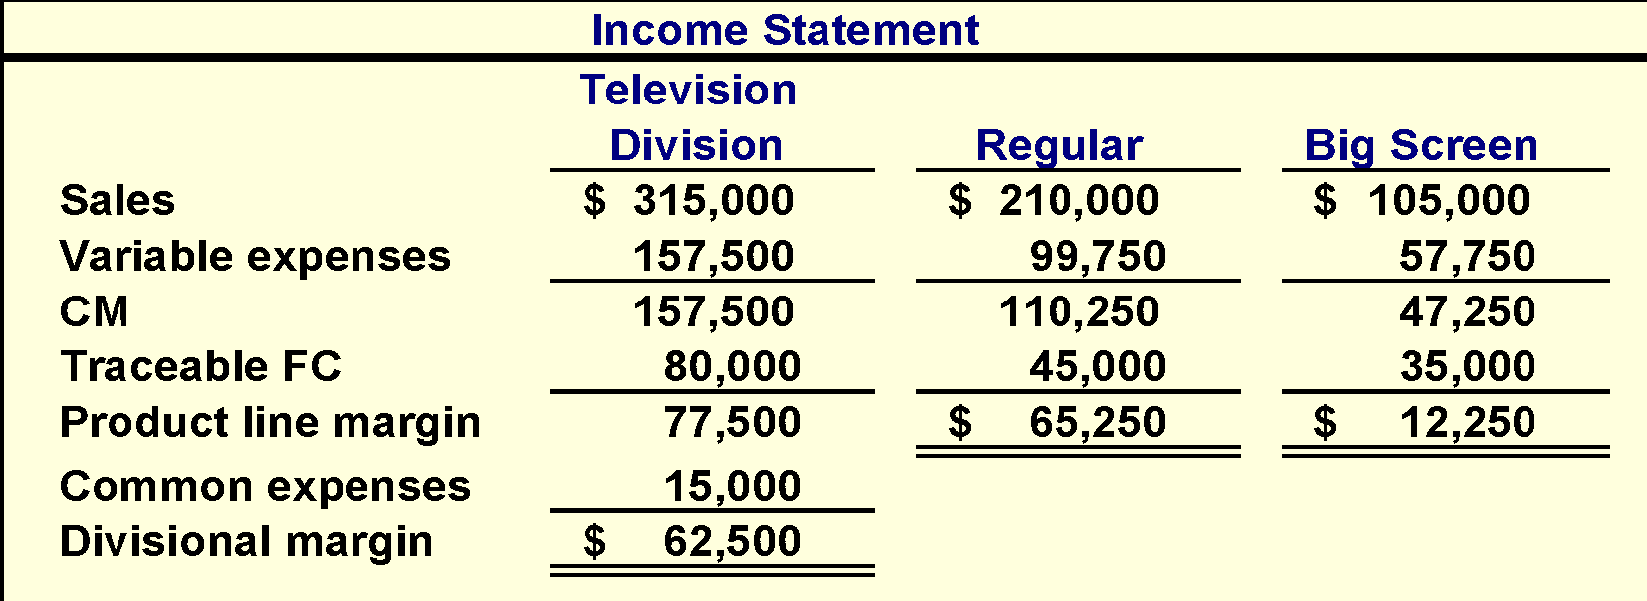
Segmented Income Statements— Decision Making
5% increase in sales
$5,000 additional advertising
Division margin increases by $2,500
Margin increases by $5,250
Margin increases by $2,250

Slide 46
Poll 5
Higado Confectionery Corporation has a number of store locations throughout North America. In income statements segmented by store, which of the following would be considered a common fixed cost with respect to the stores?
a. store manager salaries
b. store building depreciation expense
c. the cost of corporate advertising aired during the Super Bowl
d. cost of goods sold at each store

Slide 47
Learning Objective 5
Compute companywide and segment break-even points for a company with traceable fixed costs.

Slide 48
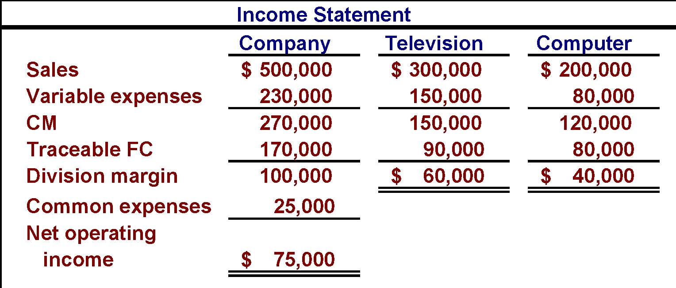
Segmented Income Statements — Break-even Analysis – Part 1
Calculate the company-wide break-even point.

Slide 49
Segmented Income Statements — Break-even Analysis – Part 2
The companywide break-even point is computed by dividing the sum of the company’s traceable fixed expenses and common fixed expenses by the company’s overall contribution margin ratio.
Break-even $170,000 + $25,000
Point 0.54
= = $361,111
Contribution Margin $270,000
Ratio $500,000
= = 0.54

Slide 50
Segmented Income Statements — Break-even Analysis – Part 3
Calculate break-even point for each business segment.

Slide 51
Segmented Income Statements — Break-even Analysis – Part 4
A business segment’s break-even point is computed by dividing its traceable fixed expenses by its contribution margin ratio.
Television
Break-even $90,000
Point 0.50
= = $180,000
Contribution Margin $150,000
Ratio $300,000
= = 0.50
Computer
Break-even $80,000
Point 0.60
= = $133,333
Contribution Margin $120,000
Ratio $200,000
= = 0.60
Notes:
If add 15K to TV FC and numerator is 105k / .5 = 210K needed to BE if you were trying to cover 105K of FC vs 180K of BE to cover true FC of only 90K. ) Pushing the common costs via a rational allocation to each Div is rational for purposes of pushing stretch goals to the lower segments, but do not do that when evaluating its true BE when you are evaluating whether to shut it down or not. If revenue came in at 200k , not 210K , you really are above your true BE of 180K, and you might shut it down, but if you did, you would lose its CM which is made up of two parts—the CM at 180K of rev which = the traceable direct FC of 90K, and the CM of another 30K of rev = 15K extra CM over the true BE to cover the 15K pushed down common FC.

Slide 52
Segmented Income Statements — Break-even Analysis – Part 5
Notice the $25,000 of companywide common fixed expenses are excluded from the segment break-even calculations because the common fixed expenses are not traceable to segments and are not influenced by segment-level decisions.

Slide 53
Omission of Costs
Costs assigned to a segment should include all costs attributable to that segment from the company’s entire value chain.
Business Functions
Making Up The
Value Chain
R&D | Product Design | Manufacturing | Marketing | Distribution | Customer Service

Slide 54
Inappropriate Methods of Allocating Costs Among Segments
Failure to trace costs directly
Costs that can be traced directly to specific segments of a company should not be allocated to other segments.
Inappropriate allocation base
Some companies allocate costs to segments using arbitrary bases. Costs should be allocated to segments only when the allocation base actually drives the cost being allocated.

Slide 55
Common Costs and Segments
Common costs should not be arbitrarily allocated to segments based on the rationale that “someone has to cover the common costs” for two reasons:
This practice may make a profitable business segment appear to be unprofitable.
Allocating common fixed costs forces managers to be held accountable for costs they cannot control.

Slide 56
Poll 6
When using data from a segmented income statement, the dollar sales for a segment to break even is equal to:
a. Traceable fixed expenses ÷ Segment CM ratio
b. Common fixed expenses ÷ Segment CM ratio
c. Traceable fixed expenses + Common fixed expenses) ÷ Segment CM ratio
d. Non-traceable fixed expenses ÷ Segment CM ratio

Slide 57
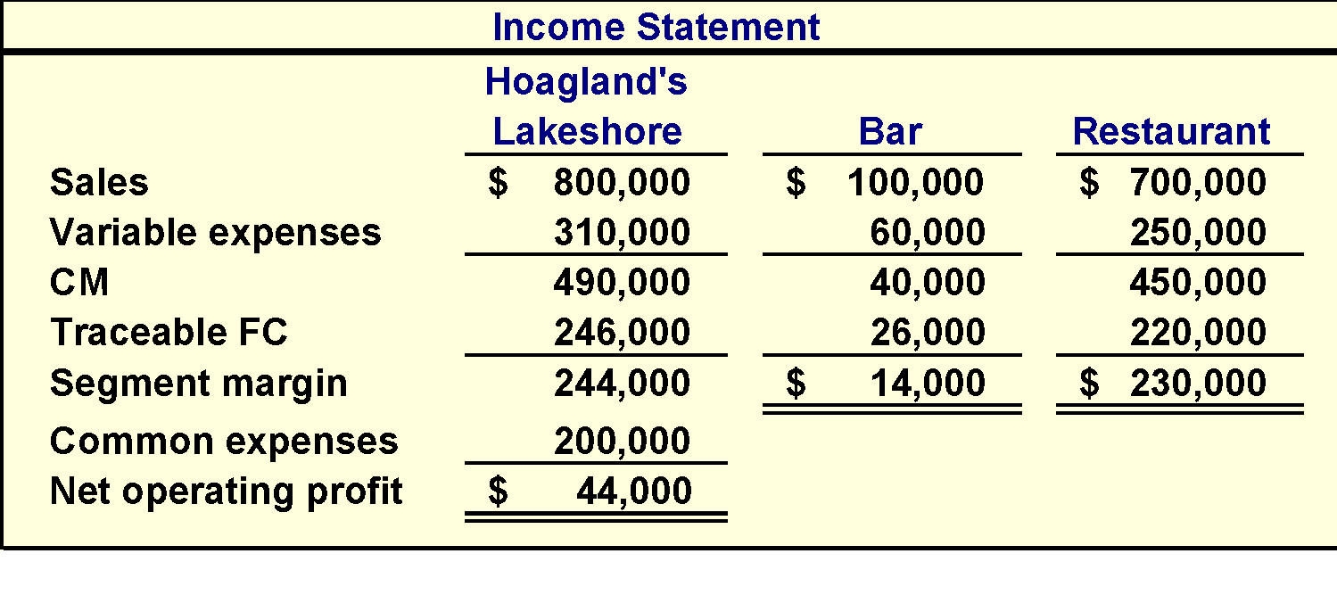
Summary Example:
Assume that Hoagland's Lakeshore prepared its segmented income statement as shown.

Slide 58
Poll 7
In theory, without needing to run any calculation, how much of the common fixed expense of $200,000 can be avoided by eliminating the bar?
a. None of it
b. Some of it
c. All of it
Common fixed expenses cannot be eliminated by dropping one of the segments.

Slide 59
Poll 8
Suppose square feet is used as the basis for allocating the common fixed expense of $200,000. How much would be allocated to the bar if the bar occupies 1,000 square feet and the restaurant 9,000 square feet?
a. $20,000
b. $30,000
c. $40,000
d. $50,000
The bar would be allocated ¹/₁₀ of the cost or $20,000.

Slide 60
If Hoagland’s allocates its common fixed expenses to the bar and the restaurant based on your previous calculation, what would be the reported profit of each segment?

Slide 61
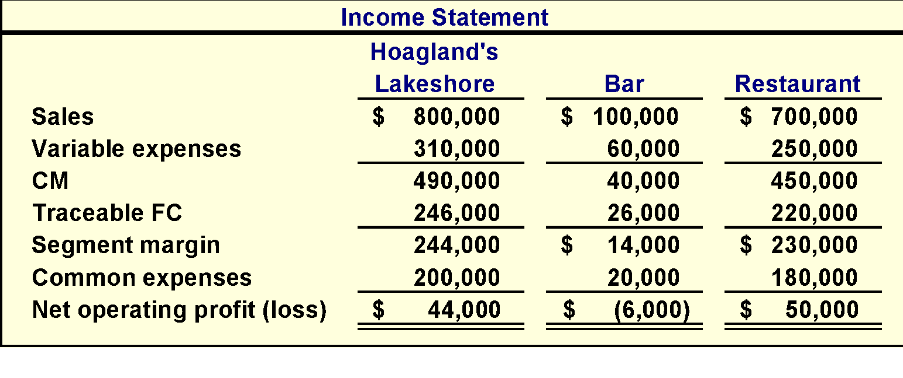
Poll 9
Do you think the Bar should be eliminated?
Yes
No

Slide 62
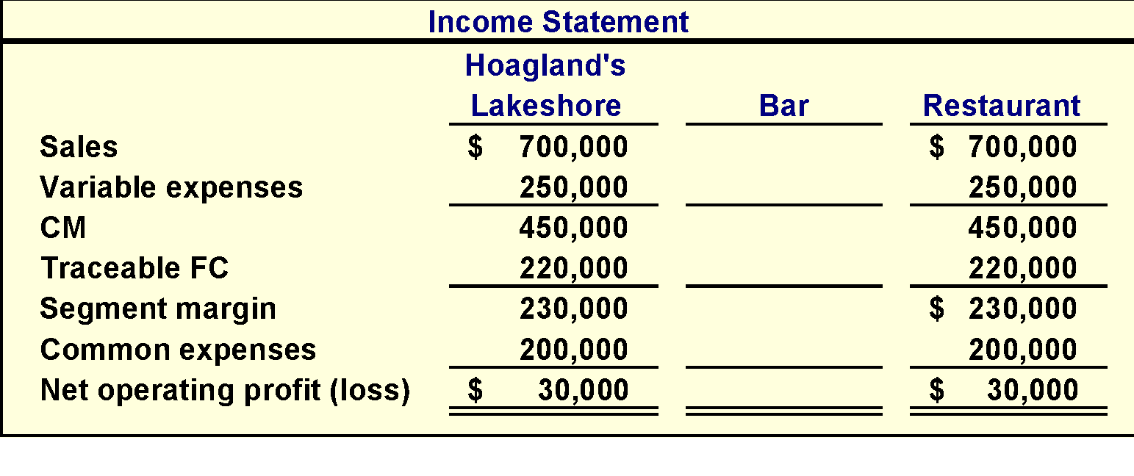
Poll 9
The profit was $44,000 before eliminating the bar. If we eliminate the bar, profit drops to $30,000!

Slide 63
End of Chapter 6

